Slide 1
Are Charging Stations Keeping Up with EV Adoption in Maryland?
By: Damir Kumukov

Slide 2
Datasets
EV dataset (MDOT)
Charging dataset (DOE)
Filtered to EV only
Converted street addresses and location to county names using GeoDataFrame
Merged

Slide 3
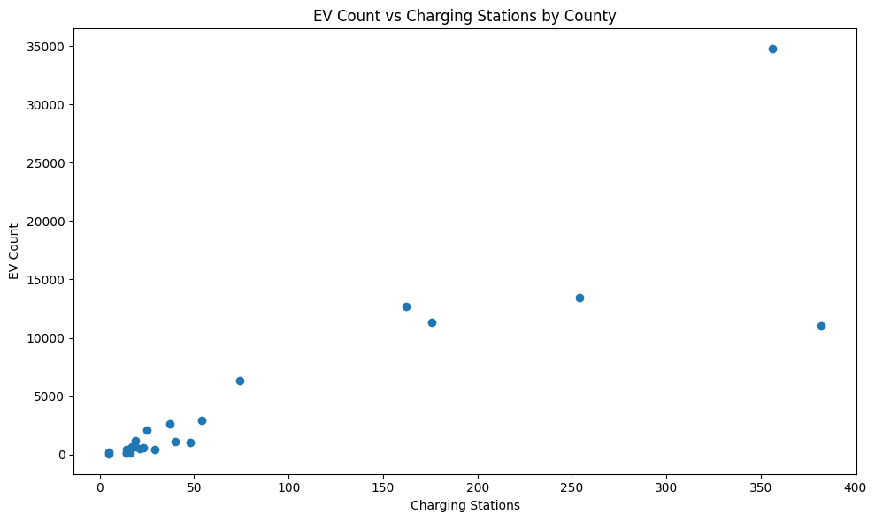
EV vs Charging
This scatter plot shows a positive relationship between EV adoption and charging stations.
Counties with more EVs tend to have more chargers.

Slide 4
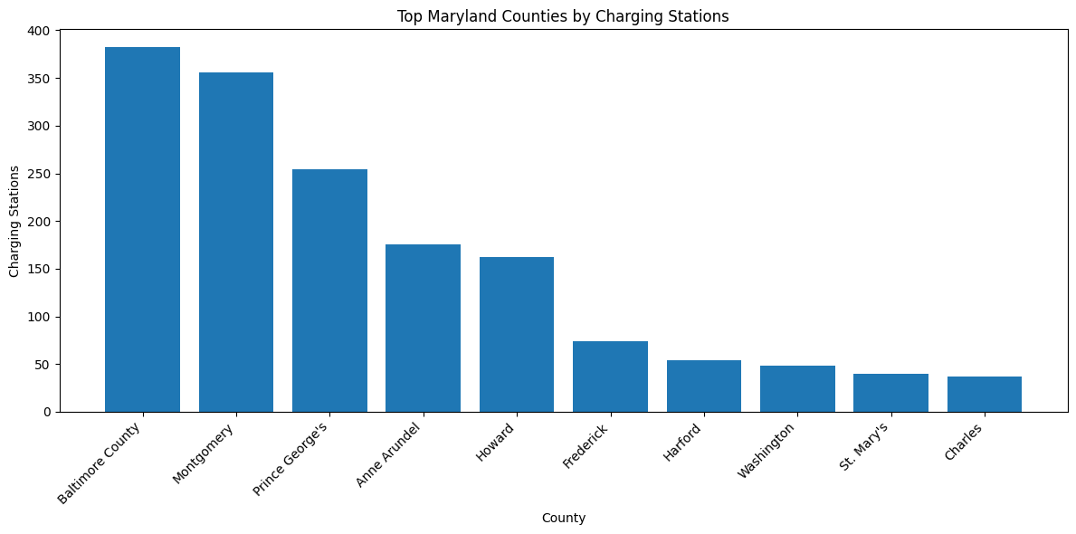
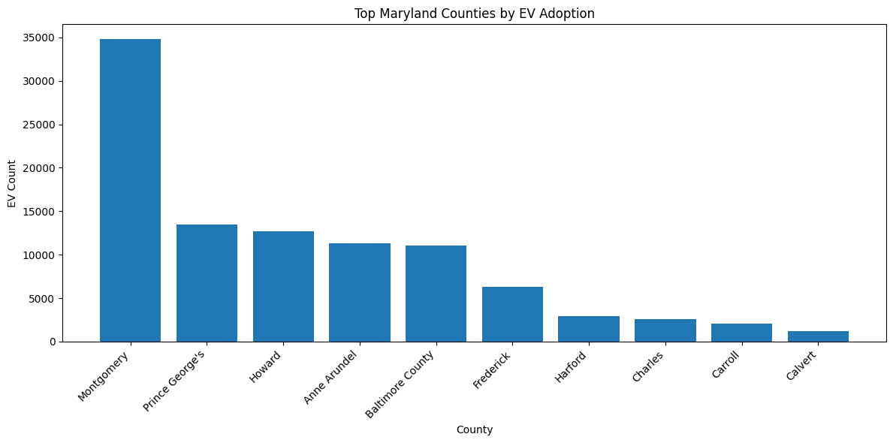
Bar Charts
We can see counties like Montgomery and Baltimore have the highest EV adoption and also the most infrastructure

Slide 5
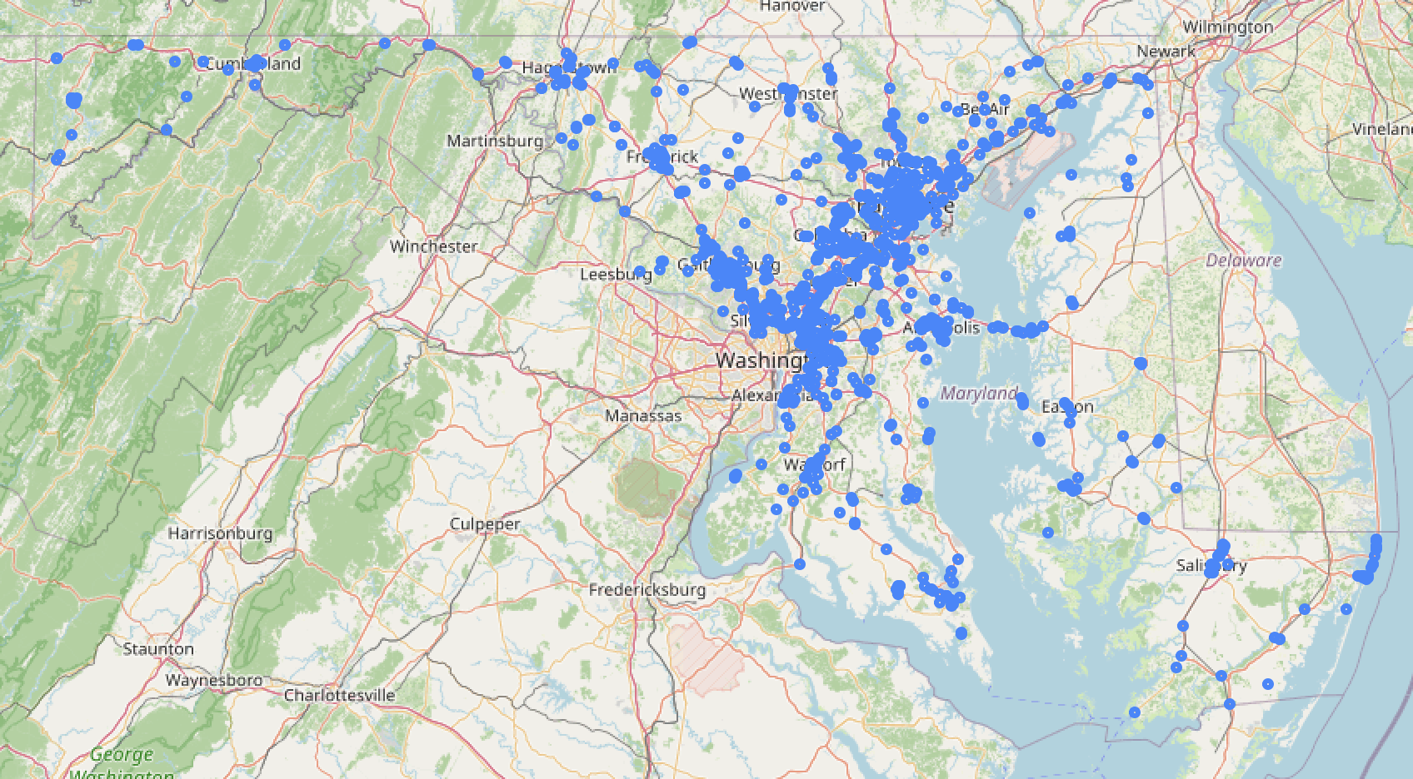
Dot Map
This map shows the actual locations of charging stations.
We can see clustering in urban areas and fewer stations in rural regions.

Slide 6
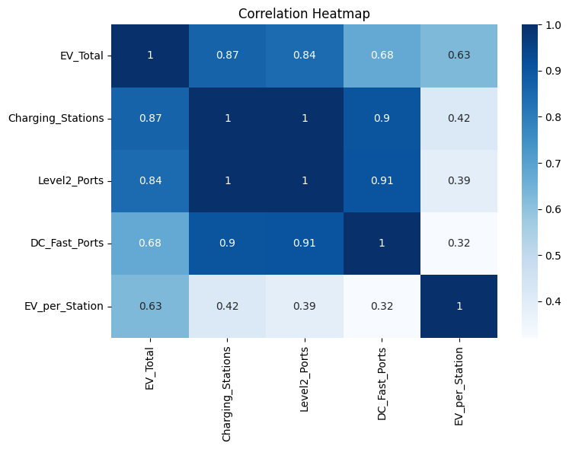
Heatmap
There is a very strong positive correlation (0.87) between the total number of Charging Stations and EV Count, meaning that physical location availability is the leading indicator for adoption.

Slide 7
Next Steps
Next, I will apply linear regression to measure the relationship between EV adoption and charging stations, and multi linear regression to compare EV count by fast chargers versus Level 2 chargers.

